Slide 1
AI-ML based : CYBER PHISHING WEBSITE DETECTION
HACKSRM5.0
Team- AI AVENGERS
Team- Shaunak Tanawade 2023April ,
legitimate urls bhi thake hote he

Slide 2
INTRODUCTION
Phishing is the most common social engineering attack performed these days.
Phishing is a method that mimics trustful uniform resource locators (URLs) and webpages to fool naïve internet users to extract sensitive information such as login credentials, bank details etc.
The objective of this project is to train machine learning models and deep neural nets on the acquired dataset to predict phishing websites.

Slide 3
Approach
PHASE-1
Collecting a dataset containing phishing and legitimate websites with its features
Extract the required features from the URL database using RFE(Recursive Feature Elimination).
Analyze and preprocess the dataset by using EDA techniques.
Divide the dataset into training and testing sets.
Run selected machine learning algorithms such as XGBoost, ExtraTree classifier, LightGBM etc on the dataset.
Display and compare obtained results based on accuracy metrics and determine best model.
PHASE-2
Develop a website where users can take Web URLs and apply that ML algorithm to detect if the site is legitimate or phishing
Admins can login and manage users and update the dataset manually.

Slide 4
Data Collection & Feature selection
We have collected the data from the site https://data.mendeley.com/datasets/c2gw7fy2j4/3 which contains both phishing and legitimate websites.
The dataset has around 11430 Urls(rows) and 89 features(columns) giving us an intensive dataset to train and test our models.
Next we performed RFE(Recursive feature elimination) to select top 30 features which we found more efficient and then deployed with various ML models .

Slide 5
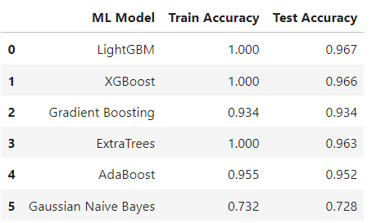
Machine Learning Models
To obtain the best model with high accuracy, several machine learning models are applied so that the model can accurately distinguish between phished and legitimate websites. The model taken are-
1) LightGBM 4) Gradient Boosting
2) XGBoost 5) AdaBoost
3) ExtraTree classifier 6) Gaussian Naïve Bayes
So these are the final efficiencies we got-

Slide 6
FUTURE SCOPE -
Creating a proper database to store newly scanned websites and continuously train the best ML model
Developing an extension of the product for easier search engine based site verification.
Developing a scanner for detecting which components of a phishing website lead to another phishing and malicious websites.
Bas

Slide 7
THANK YOU

